Slide 1

Arrays and Lists
Lecture 7
CS61B, Spring 2024 @ UC Berkeley
Slides credit: Josh Hug
Notes:
http://www.portcalls.com/wp-content/uploads/2012/04/hanging_containers1.jpg

Slide 2
A Last Look at Linked Lists
A Last Look at Linked Lists
Naive ArrayLists
Basic ArrayList Implementation
The Allegory of the Cave
removeLast Implementation
Resizing ArrayLists
Resizing Array Theory
Resizing Array Implementation
Runtime Analysis (Warmup)
Runtime Analysis
Better Resizing Strategy
Generic ArrayLists
Obscurantism in Java
Lecture 7, CS61B, Spring 2024

Slide 3
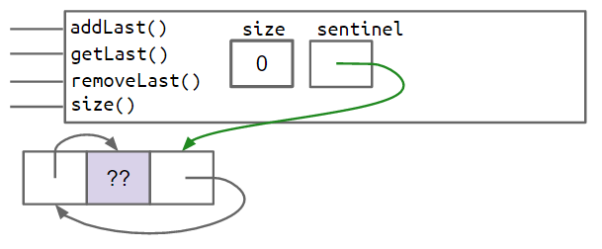
Doubly Linked Lists
Behold. The state of the art as we arrived at in last week’s lecture. Through various improvements, we made all of the following operations fast:
addFirst, addLast
getFirst, getLast
removeFirst, removeLast
You will build this in project 1A.
addLast()
size
sentinel
getLast()
3
removeLast()
get(int i)
??
5
17
38
prev
value
next

Slide 4
Arbitrary Retrieval
Suppose we added get(int i), which returns the ith item from the list.
Why would get be slow for long lists compared to getLast()? For what inputs?
addLast()
size
sentinel
getLast()
3
removeLast()
get(int i)
??
5
17
38
prev
value
next

Slide 5
Arbitrary Retrieval
Suppose we added get(int i), which returns the ith item from the list.
Why would get be slow for long lists compared to getLast()? For what inputs?
Have to scan to desired position. Slow for any i not near the sentinel node.
How do we fix this?
addLast()
size
sentinel
getLast()
3
removeLast()
get(int i)
??
5
17
38
prev
value
next

Slide 6
Arbitrary Retrieval
Suppose we added get(int i), which returns the ith item from the list.
Why would get be slow for long lists compared to getLast()? For what inputs?
Have to scan to desired position. Slow for any i not near the sentinel node.
Will discuss (much later) sophisticated changes that can speed things up.
For today: We’ll take a different tack: Using an array instead (no links!).
addLast()
size
sentinel
getLast()
3
removeLast()
get(int i)
??
5
17
38
prev
value
next

Slide 7
Basic ArrayList Implementation
A Last Look at Linked Lists
Naive ArrayLists
Basic ArrayList Implementation
The Allegory of the Cave
removeLast Implementation
Resizing ArrayLists
Resizing Array Theory
Resizing Array Implementation
Runtime Analysis (Warmup)
Runtime Analysis
Better Resizing Strategy
Generic ArrayLists
Obscurantism in Java
Lecture 7, CS61B, Spring 2024

Slide 8
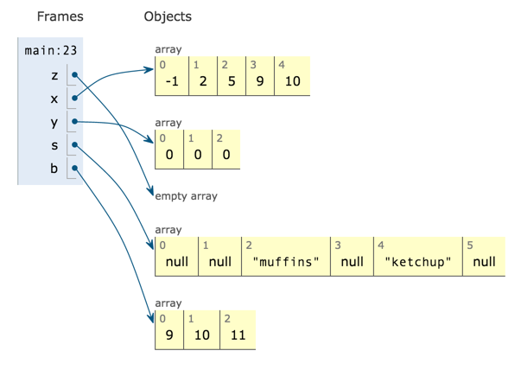
Random Access in Arrays
Retrieval from any position of an array is very fast.
Independent* of array size.
61C Preview: Ultra fast random access results from the fact that memory boxes are the same size (in bits).

Slide 9
Our Goal: AList.java
Want to figure out how to build an array version of a list:
In lecture we’ll only do back operations. Project 1B is the front operations.
SLList
addLast()
size
sentinel
getLast()
3
removeLast()
get(int i)
??
5
17
38
prev
value
next
AList
addLast()
getLast()
???
removeLast()
Let’s try it out...
get(int i)

Slide 10
Coding Demo: Basic ArrayList Constructor
AList.java
public class AList {
/** Creates an empty list. */
public AList() {
}
}

Slide 11
Coding Demo: Basic ArrayList Constructor
AList.java
public class AList {
private int size;
/** Creates an empty list. */
public AList() {
}
}

Slide 12
Coding Demo: Basic ArrayList Constructor
AList.java
public class AList {
private int[] items;
private int size;
/** Creates an empty list. */
public AList() {
}
}

Slide 13
Coding Demo: Basic ArrayList Constructor
AList.java
public class AList {
private int[] items;
private int size;
/** Creates an empty list. */
public AList() {
items = new int[100];
}
}
The choice of array size (100) was arbitrary. We'll fix this limitation later.

Slide 14
Coding Demo: Basic ArrayList Constructor
AList.java
public class AList {
private int[] items;
private int size;
/** Creates an empty list. */
public AList() {
items = new int[100];
size = 0;
}
}

Slide 15
Coding Demo: Basic ArrayList addLast
AList.java
public class AList {
private int[] items;
private int size;
/** Inserts x into the back of the list. */
public void addLast(int x) {
}
}
Let's write a small example to help us think about addLast.

Slide 16
Coding Demo: Basic ArrayList addLast
Call constructor to get empty array.
0 | 0 | 0 | 0 | 0 | 0 | 0 | 0 | 0 | 0
0 | 1 | 2 | 3 | 4 | 5 | 6 | 7 | 8 | …
size=0
addLast(6)
6 | 0 | 0 | 0 | 0 | 0 | 0 | 0 | 0 | 0
0 | 1 | 2 | 3 | 4 | 5 | 6 | 7 | 8 | …
size=1
addLast(9)
6 | 9 | 0 | 0 | 0 | 0 | 0 | 0 | 0 | 0
0 | 1 | 2 | 3 | 4 | 5 | 6 | 7 | 8 | …
size=2
addLast(-1)
6 | 9 | -1 | 0 | 0 | 0 | 0 | 0 | 0 | 0
0 | 1 | 2 | 3 | 4 | 5 | 6 | 7 | 8 | …
size=3
What patterns do we spot?
The next item we want to add will go into position size.

Slide 17
Coding Demo: Basic ArrayList addLast
AList.java
/** Invariants:
addLast: The next item we want to add, will go into position size
*/
public class AList {
private int[] items;
private int size;
/** Inserts x into the back of the list. */
public void addLast(int x) {
}
}

Slide 18
Coding Demo: Basic ArrayList addLast
AList.java
/** Invariants:
addLast: The next item we want to add, will go into position size
*/
public class AList {
private int[] items;
private int size;
/** Inserts x into the back of the list. */
public void addLast(int x) {
items[size] = x;
}
}

Slide 19
Coding Demo: Basic ArrayList addLast
AList.java
/** Invariants:
addLast: The next item we want to add, will go into position size
*/
public class AList {
private int[] items;
private int size;
/** Inserts x into the back of the list. */
public void addLast(int x) {
items[size] = x;
size += 1;
}
}

Slide 20
Coding Demo: Basic ArrayList getLast
AList.java
/** Invariants:
addLast: The next item we want to add, will go into position size
*/
public class AList {
private int[] items;
private int size;
/** Returns the item from the back of the list. */
public int getLast() {
}
}

Slide 21
Coding Demo: Basic ArrayList getLast
AList.java
/** Invariants:
addLast: The next item we want to add, will go into position size
getLast: The item we want to return is in position size - 1.
*/
public class AList {
private int[] items;
private int size;
/** Returns the item from the back of the list. */
public int getLast() {
}
}

Slide 22
Coding Demo: Basic ArrayList getLast
AList.java
/** Invariants:
addLast: The next item we want to add, will go into position size
getLast: The item we want to return is in position size - 1.
*/
public class AList {
private int[] items;
private int size;
/** Returns the item from the back of the list. */
public int getLast() {
return items[size - 1];
}
}

Slide 23
Coding Demo: Basic ArrayList get
AList.java
/** Invariants:
addLast: The next item we want to add, will go into position size
getLast: The item we want to return is in position size - 1.
*/
public class AList {
private int[] items;
private int size;
/** Gets the ith item in the list (0 is the front). */
public int get(int i) {
}
}

Slide 24
Coding Demo: Basic ArrayList get
AList.java
/** Invariants:
addLast: The next item we want to add, will go into position size
getLast: The item we want to return is in position size - 1.
*/
public class AList {
private int[] items;
private int size;
/** Gets the ith item in the list (0 is the front). */
public int get(int i) {
return items[i];
}
}

Slide 25
Coding Demo: Basic ArrayList size
AList.java
/** Invariants:
addLast: The next item we want to add, will go into position size
getLast: The item we want to return is in position size - 1.
*/
public class AList {
private int[] items;
private int size;
/** Returns the number of items in the list. */
public int size() {
}
}

Slide 26
Coding Demo: Basic ArrayList size
AList.java
/** Invariants:
addLast: The next item we want to add, will go into position size
getLast: The item we want to return is in position size - 1.
size: The number of items in the list should be size.
*/
public class AList {
private int[] items;
private int size;
/** Returns the number of items in the list. */
public int size() {
}
}

Slide 27
Coding Demo: Basic ArrayList size
AList.java
/** Invariants:
addLast: The next item we want to add, will go into position size
getLast: The item we want to return is in position size - 1.
size: The number of items in the list should be size.
*/
public class AList {
private int[] items;
private int size;
/** Returns the number of items in the list. */
public int size() {
return size;
}
}

Slide 28
Naive AList Code
From SLList lecture: “things that must be true”.
public class AList {
private int[] items;
private int size;
public AList() {
items = new int[100]; size = 0;
}
public void addLast(int x) {
items[size] = x;
size += 1;
}
public int getLast() {
return items[size - 1];
}
public int get(int i) {
return items[i];
}
public int size() {
return size;
}
}
AList Invariants:
The position of the next item to be inserted is always size.
size is always the number of items in the AList.
The last item in the list is always in position size - 1.
We could also add error checking code, e.g.
public int get(int i) {
if (i >= items.length) {
throw new IllegalArgumentException();
}
return items[i];
}

Slide 29
Naive AList Code
From SLList lecture: “things that must be true”.
public class AList {
private int[] items;
private int size;
public AList() {
items = new int[100]; size = 0;
}
public void addLast(int x) {
items[size] = x;
size += 1;
}
public int getLast() {
return items[size - 1];
}
public int get(int i) {
return items[i];
}
public int size() {
return size;
}
}
AList Invariants:
The position of the next item to be inserted is always size.
size is always the number of items in the AList.
The last item in the list is always in position size - 1.
Let’s now discuss delete operations.

Slide 30
The Allegory of the Cave
A Last Look at Linked Lists
Naive ArrayLists
Basic ArrayList Implementation
The Allegory of the Cave
removeLast Implementation
Resizing ArrayLists
Resizing Array Theory
Resizing Array Implementation
Runtime Analysis (Warmup)
Runtime Analysis
Better Resizing Strategy
Generic ArrayLists
Obscurantism in Java
Lecture 7, CS61B, Spring 2024

Slide 31

The Abstract vs. the Concrete
When we removeLast(), which memory boxes need to change? To what?-
User’s mental model: {5, 3, 1, 7, 22, -1} → {5, 3, 1, 7, 22}
Actual truth:
addLast()
getLast()
size
items
removeLast()
6
get(int i)
5
3
1
7
22
-1
0
0
...
0
0
0 1 2 3 4 5 6 7 98 99
Notes:
http://www.learning-mind.com/plato-allegory-of-the-cave/

Slide 32
Deletion: yellkey.com/look
When we removeLast(), which memory boxes need to change? To what?
size
size and items
size and items[i] for some i
size, items, and items[i] for some i
size, items, and items[i] for many different i
addLast()
getLast()
size
items
removeLast()
6
get(int i)
5
3
1
7
22
-1
0
0
...
0
0
0
0 1 2 3 4 5 6 7 97 98 99
The position of the next item to be inserted is always size.
size is always the number of items in the AList.
The last item in the list is always in position size - 1.
AList invariants.
Notes:
https://docs.google.com/forms/d/e/1FAIpQLSfA8RFRMoRG9cTGHFEny2c8WyDkHZqwO1zAqh7sURgFDjjJWA/viewform

Slide 33
removeLast Implementation
A Last Look at Linked Lists
Naive ArrayLists
Basic ArrayList Implementation
The Allegory of the Cave
removeLast Implementation
Resizing ArrayLists
Resizing Array Theory
Resizing Array Implementation
Runtime Analysis (Warmup)
Runtime Analysis
Better Resizing Strategy
Generic ArrayLists
Obscurantism in Java
Lecture 7, CS61B, Spring 2024

Slide 34
Deletion Debrief
When we removeLast(), which memory boxes need to change? To what?
size
size and items
size and items[i] for some i
size, items, and items[i] for some i
size, items, and items[i] for many different i
addLast()
getLast()
size
items
removeLast()
6
get(int i)
5
3
1
7
22
-1
0
0
...
0
0
0
0 1 2 3 4 5 6 7 97 98 99
The position of the next item to be inserted is always size.
size is always the number of items in the AList.
The last item in the list is always in position size - 1.
AList invariants.

Slide 35
Coding Demo: Basic ArrayList removeLast
AList.java
/** Invariants:
addLast: The next item we want to add, will go into position size
getLast: The item we want to return is in position size - 1.
size: The number of items in the list should be size.
*/
public class AList {
private int[] items;
private int size;
/** Deletes item from back of list and returns deleted item. */
public int removeLast() {
}
}

Slide 36
Coding Demo: Basic ArrayList removeLast
AList.java
/** Invariants:
addLast: The next item we want to add, will go into position size
getLast: The item we want to return is in position size - 1.
size: The number of items in the list should be size.
*/
public class AList {
private int[] items;
private int size;
/** Deletes item from back of list and returns deleted item. */
public int removeLast() {
int x = getLast();
}
}

Slide 37
Coding Demo: Basic ArrayList removeLast
AList.java
/** Invariants:
addLast: The next item we want to add, will go into position size
getLast: The item we want to return is in position size - 1.
size: The number of items in the list should be size.
*/
public class AList {
private int[] items;
private int size;
/** Deletes item from back of list and returns deleted item. */
public int removeLast() {
int x = getLast();
return x;
}
}

Slide 38
Coding Demo: Basic ArrayList removeLast
AList.java
/** Invariants:
addLast: The next item we want to add, will go into position size
getLast: The item we want to return is in position size - 1.
size: The number of items in the list should be size.
*/
public class AList {
private int[] items;
private int size;
/** Deletes item from back of list and returns deleted item. */
public int removeLast() {
int x = getLast();
size = size - 1;
return x;
}
}

Slide 39
Naive AList Code
public class AList {
private int[] items;
private int size;
public AList() {
items = new int[100]; size = 0;
}
public void addLast(int x) {
items[size] = x;
size += 1;
}
public int getLast() {
return items[size - 1];
}
public int get(int i) {
return items[i];
}
public int size() {
return size;
}
}
AList Invariants:
The position of the next item to be inserted is always size.
size is always the number of items in the AList.
The last item in the list is always in position size - 1.
Setting deleted item to zero is not necessary to preserve invariants, and thus not necessary for correctness.
public int removeLast() {
int x = items[size - 1];
items[size - 1] = 0;
size -= 1;
return x;
}

Slide 40
Note
What about get?
Some students suggest we should set the value to zero so that we can’t get(5).
There’s no specified behavior for what to do when get is out of bounds.
IMO an exception is best.
addLast()
getLast()
size
items
removeLast()
5
get(int i)
5
3
1
7
22
-1
0
0
...
0
0
0
0 1 2 3 4 5 6 7 97 98 99

Slide 41
Resizing Array Theory
A Last Look at Linked Lists
Naive ArrayLists
Basic ArrayList Implementation
The Allegory of the Cave
removeLast Implementation
Resizing ArrayLists
Resizing Array Theory
Resizing Array Implementation
Runtime Analysis (Warmup)
Runtime Analysis
Better Resizing Strategy
Generic ArrayLists
Obscurantism in Java
Lecture 7, CS61B, Spring 2024

Slide 42
The Mighty AList
Key Idea: Use some subset of the entries of an array.
addLast()
getLast()
size
items
removeLast()
6
get(int i)
5
3
1
7
22
-1
3
2
...
7
12
4
0 1 2 3 4 5 6 7 97 98 99

Slide 43
The Mighty (?) AList
Key Idea: Use some subset of the entries of an array.
addLast()
getLast()
size
items
removeLast()
100
get(int i)
5
3
1
7
22
-1
5
7
...
-1
5
7
0 1 2 3 4 5 6 7 97 98 99
What happens if we insert into the AList above? What should we do about it?

Slide 44
Array Resizing
size==items.length
When the array gets too full, e.g. addLast(11), just make a new array:
addLast()
getLast()
size
items
removeLast()
100
get(int i)
5
3
1
7
22
-1
5
7
...
-1
5
7
0 1 2 3 4 5 6 7 97 98 99

Slide 45
Array Resizing
size==items.length
When the array gets too full, e.g. addLast(11), just make a new array:
int[] a = new int[size+1];
addLast()
getLast()
size
items
removeLast()
100
get(int i)
5
3
1
7
22
-1
5
7
...
-1
5
7
a
0 1 2 3 4 5 6 7 97 98 99
0
0
0
0
0
0
0
0
...
0
0
0
0
0 1 2 3 4 5 6 7 97 98 99 100

Slide 46
Array Resizing
size==items.length
When the array gets too full, e.g. addLast(11), just make a new array:
int[] a = new int[size+1];
System.arraycopy(...)
addLast()
getLast()
size
items
removeLast()
100
get(int i)
5
3
1
7
22
-1
5
7
...
-1
5
7
a
0 1 2 3 4 5 6 7 97 98 99
5
3
1
7
22
-1
5
7
...
-1
5
7
0
0 1 2 3 4 5 6 7 97 98 99 100

Slide 47
Array Resizing
size==items.length
When the array gets too full, e.g. addLast(11), just make a new array:
int[] a = new int[size+1];
System.arraycopy(...)
a[size] = 11;
addLast()
getLast()
size
items
removeLast()
100
get(int i)
5
3
1
7
22
-1
5
7
...
-1
5
7
a
0 1 2 3 4 5 6 7 97 98 99
5
3
1
7
22
-1
5
7
...
-1
5
7
11
0 1 2 3 4 5 6 7 97 98 99 100

Slide 48
Array Resizing
size==items.length
When the array gets too full, e.g. addLast(11), just make a new array:
int[] a = new int[size+1];
System.arraycopy(...)
a[size] = 11;
items = a; size +=1;
addLast()
getLast()
size
items
removeLast()
101
get(int i)
5
3
1
7
22
-1
5
7
...
-1
5
7
a
0 1 2 3 4 5 6 7 97 98 99
5
3
1
7
22
-1
5
7
...
-1
5
7
11
0 1 2 3 4 5 6 7 97 98 99 100

Slide 49
Array Resizing
size==items.length
When the array gets too full, e.g. addLast(11), just make a new array:
int[] a = new int[size+1];
System.arraycopy(...)
a[size] = 11;
items = a; size +=1;
addLast()
getLast()
size
items
removeLast()
101
get(int i)
We call this process “resizing”
a
5
3
1
7
22
-1
5
7
...
-1
5
7
11
0 1 2 3 4 5 6 7 97 98 99 100

Slide 50
Resizing Array Implementation
A Last Look at Linked Lists
Naive ArrayLists
Basic ArrayList Implementation
The Allegory of the Cave
removeLast Implementation
Resizing ArrayLists
Resizing Array Theory
Resizing Array Implementation
Runtime Analysis (Warmup)
Runtime Analysis
Better Resizing Strategy
Generic ArrayLists
Obscurantism in Java
Lecture 7, CS61B, Spring 2024

Slide 51
Implementation
Let’s implement the resizing capability.
As usual, for those of you watching online, I recommend trying to implement this on your own before watching me do it.
Starter code is provided in the lists4 study guide if you want to try it out on a computer.

Slide 52
Coding Demo: Resizing Array
AList.java
public class AList {
/** Inserts x into the back of the list. */
public void addLast(int x) {
items[size] = x;
size += 1;
}
}

Slide 53
Coding Demo: Resizing Array
AList.java
public class AList {
/** Inserts x into the back of the list. */
public void addLast(int x) {
if (size == items.length) {
}
items[size] = x;
size += 1;
}
}

Slide 54
Coding Demo: Resizing Array
AList.java
public class AList {
/** Inserts x into the back of the list. */
public void addLast(int x) {
if (size == items.length) {
int[] a = new int[size + 1];
}
items[size] = x;
size += 1;
}
}

Slide 55
Coding Demo: Resizing Array
AList.java
public class AList {
/** Inserts x into the back of the list. */
public void addLast(int x) {
if (size == items.length) {
int[] a = new int[size + 1];
System.arraycopy(items, 0, a, 0, size);
}
items[size] = x;
size += 1;
}
}

Slide 56
Coding Demo: Resizing Array
AList.java
public class AList {
/** Inserts x into the back of the list. */
public void addLast(int x) {
if (size == items.length) {
int[] a = new int[size + 1];
System.arraycopy(items, 0, a, 0, size);
items = a;
}
items[size] = x;
size += 1;
}
}

Slide 57
Coding Demo: Resizing Array
AList.java
public class AList {
/** Inserts x into the back of the list. */
public void addLast(int x) {
if (size == items.length) {
int[] a = new int[size + 1];
System.arraycopy(items, 0, a, 0, size);
items = a;
}
items[size] = x;
size += 1;
}
}
The resizing functionality is really its own independent operation, separate from addLast.
We could organize our code better by moving this code into its own function.

Slide 58
Coding Demo: Resizing Array
AList.java
public class AList {
/** Resizes the underlying array to the target capacity. */
private void resize(int capacity) {
}
/** Inserts x into the back of the list. */
public void addLast(int x) {
if (size == items.length) {
int[] a = new int[size + 1];
System.arraycopy(items, 0, a, 0, size);
items = a;
}
items[size] = x;
size += 1;
}
}

Slide 59
Coding Demo: Resizing Array
AList.java
public class AList {
/** Resizes the underlying array to the target capacity. */
private void resize(int capacity) {
int[] a = new int[size + 1];
System.arraycopy(items, 0, a, 0, size);
items = a;
}
/** Inserts x into the back of the list. */
public void addLast(int x) {
if (size == items.length) {
}
items[size] = x;
size += 1;
}
}

Slide 60
Coding Demo: Resizing Array
AList.java
public class AList {
/** Resizes the underlying array to the target capacity. */
private void resize(int capacity) {
int[] a = new int[capacity];
System.arraycopy(items, 0, a, 0, size);
items = a;
}
/** Inserts x into the back of the list. */
public void addLast(int x) {
if (size == items.length) {
}
items[size] = x;
size += 1;
}
}

Slide 61
Coding Demo: Resizing Array
AList.java
public class AList {
/** Resizes the underlying array to the target capacity. */
private void resize(int capacity) {
int[] a = new int[capacity];
System.arraycopy(items, 0, a, 0, size);
items = a;
}
/** Inserts x into the back of the list. */
public void addLast(int x) {
if (size == items.length) {
resize(size + 1);
}
items[size] = x;
size += 1;
}
}

Slide 62
Resizing Array Code
private void resize(int capacity) {
int[] a = new int[capacity];
System.arraycopy(items, 0, a, 0, size);
items = a;
}
public void addLast(int x) {
if (size == items.length) {
resize(size + 1);
}
items[size] = x;
size += 1;
}
public void addLast(int x) {
if (size == items.length) {
int[] a = new int[size + 1];
System.arraycopy(items, 0, a, 0, size);
items = a;
}
items[size] = x;
size += 1;
}
Works
Much Better
Easier to read and understand.
Easier to test the correctness of each function.

Slide 63
Runtime Analysis (Warmup)
A Last Look at Linked Lists
Naive ArrayLists
Basic ArrayList Implementation
The Allegory of the Cave
removeLast Implementation
Resizing ArrayLists
Resizing Array Theory
Resizing Array Implementation
Runtime Analysis (Warmup)
Runtime Analysis
Better Resizing Strategy
Generic ArrayLists
Obscurantism in Java
Lecture 7, CS61B, Spring 2024

Slide 64
Runtime and Space Usage Analysis: yellkey.com/think
Suppose we have a full array of size 100. If we call addLast two times, how many total array memory boxes will we need to create and fill (for just these 2 calls)?
0
101
203
10,302
private void resize(int capacity) {
int[] a = new int[capacity];
System.arraycopy(items, 0, a, 0, size);
items = a;
}
public void addLast(int x) {
if (size == items.length) {
resize(size + 1);
}
items[size] = x;
size += 1;
}
Bonus question: What is the maximum number of array boxes that Java will track at any given time? Assume that “garbage collection” happens immediately when all references to an object are lost.
Notes:
https://docs.google.com/forms/d/e/1FAIpQLSfr4dC4EZVWn-HCoMJv9_8AMAYfy1ILtq9FfMdbdDfcn7u5Rw/viewform

Slide 65
Array Resizing
Resizing twice requires us to create and fill 203 total memory boxes.
Bonus answer: Most boxes at any one time is 203.
When the second addLast is done, we are left with 102 boxes.
100
5
3
1
7
22
-1
5
7
...
-1
5
7
0 1 2 3 4 5 6 7 97 98 99
101
5
3
1
7
22
-1
5
7
...
-1
5
7
11
0 1 2 3 4 5 6 7 97 98 99 100
102
5
3
1
7
22
-1
5
7
...
-1
5
7
11
3
0 1 2 3 4 5 6 7 97 98 99 100 101

Slide 66
Runtime Analysis
A Last Look at Linked Lists
Naive ArrayLists
Basic ArrayList Implementation
The Allegory of the Cave
removeLast Implementation
Resizing ArrayLists
Resizing Array Theory
Resizing Array Implementation
Runtime Analysis (Warmup)
Runtime Analysis
Better Resizing Strategy
Generic ArrayLists
Obscurantism in Java
Lecture 7, CS61B, Spring 2024

Slide 67
Demo: Speed Testing the ArrayList
SpeedTestSLList.java
public class SpeedTestSLList {
public static void main(String[] args) {
SLList<Integer> L = new SLList<>();
int i = 0;
while (i < 100000) {
L.addFirst(i);
i = i + 1;
}
}
}
jug ~/.../lists4/speedtest
$ time java SpeedTestSLList
real 0m0.058s
user 0m0.060s
sys 0m0.004s
Adding 100,000 items to a new SLList is very fast (~0.05 seconds).

Slide 68
Demo: Speed Testing the ArrayList
SpeedTestAList.java
public class SpeedTestAList {
public static void main(String[] args) {
AList L = new AList();
int i = 0;
while (i < 100000) {
L.addLast(i);
i = i + 1;
}
}
}
jug ~/.../lists4/speedtest
$ time java SpeedTestAList
real 0m2.945s
user 0m2.872s
sys 0m0.068s
Adding 100,000 items to a new AList is very slow (~3 seconds).

Slide 69
Runtime and Space Usage Analysis: yellkey.com/TODO
Suppose we have a full array of size 100. If we call addLast until size = 1000, roughly how many total array memory boxes will we need to create and fill?
1,000
500,000
1,000,000
500,000,000,000
1,000,000,000,000
private void resize(int capacity) {
int[] a = new int[capacity];
System.arraycopy(items, 0, a, 0, size);
items = a;
}
public void addLast(int x) {
if (size == items.length) {
resize(size + 1);
}
items[size] = x;
size += 1;
}
Bonus question: What is the maximum number of array boxes that Java will track at any given time? Assume that “garbage collection” happens immediately when all references to an object are lost.

Slide 70
Runtime and Space Usage Analysis
Suppose we have a full array of size 100. If we call addLast until size = 1000, roughly how many total array memory boxes will we need to create and fill?
B. 500,000
Going from capacity 100 to 101: 101
From 101 to 102: 102
…
From: 999 to 1000: 1000
Total array boxes created/copied: 101 + 102 + … + 1000
Since sum of 1 + 2 + 3 + … + N = N(N+1)/2, sum(101, …, 1000) is close to 500,000.
See: http://mathandmultimedia.com/2010/09/15/sum-first-n-positive-integers
private void resize(int capacity) {
int[] a = new int[capacity];
System.arraycopy(items, 0, a, 0, size);
items = a;
}
We’ll be doing a lot of this after the midterm.

Slide 71
Runtime and Space Usage Analysis
Since sum of 1 + 2 + 3 + … + N = N(N+1)/2, sum(101, …, 1000) is close to 500,000.
Rough intuition: Form pairs that all sum to N+1:
N + 1
(N-1) + 2
(N-2) + 3
...
There are N/2 such pairs.
1 + 2 + 3 + 4 + 5 + ... + (N-4) + (N-3) + (N-2) + (N-1) + N

Slide 72
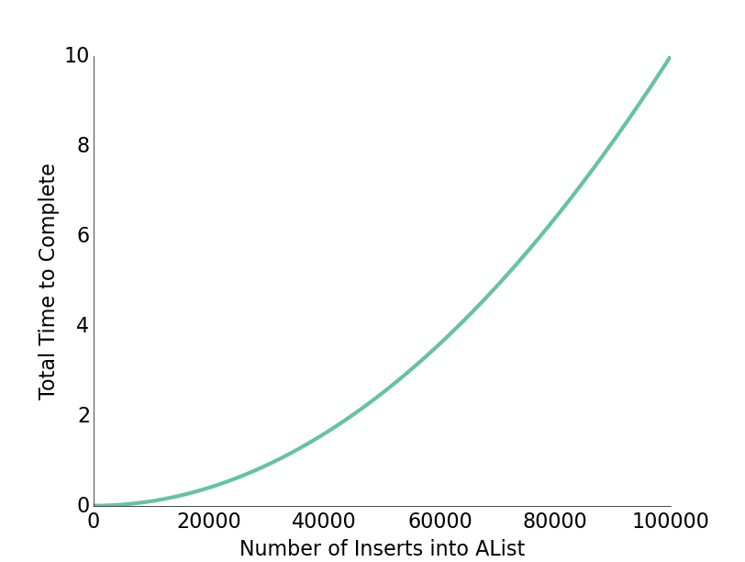
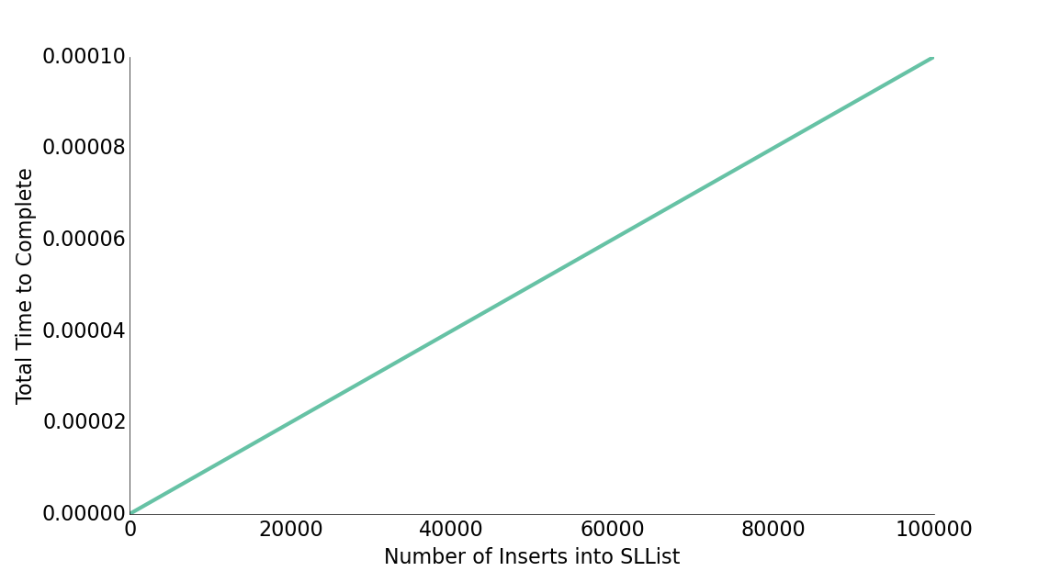
Resizing Slowness
Inserting 100,000 items requires roughly 5,000,000,000 new containers.
Computers operate at the speed of GHz (due billions of things per second).
No huge surprise that 100,000 items took seconds.
Note: Insert here is addFirst

Slide 73
Resizing Slowness
Inserting 100,000 items requires roughly 5,000,000,000 new containers.
Computers operate at the speed of GHz (due billions of things per second).
No huge surprise that 100,000 items took seconds.
The same graphs from the previous slide, placed on top of each other.
Red line = SLList
Teal line = AList
Number of inserts into list

Slide 74
Better Resizing Strategy
A Last Look at Linked Lists
Naive ArrayLists
Basic ArrayList Implementation
The Allegory of the Cave
removeLast Implementation
Resizing ArrayLists
Resizing Array Theory
Resizing Array Implementation
Runtime Analysis (Warmup)
Runtime Analysis
Better Resizing Strategy
Generic ArrayLists
Obscurantism in Java
Lecture 7, CS61B, Spring 2024

Slide 75
Fixing the Resizing Performance Bug
How do we fix this?
private void resize(int capacity) {
int[] a = new int[capacity];
System.arraycopy(items, 0, a, 0, size);
items = a;
}
public void addLast(int x) {
if (size == items.length) {
resize(size + 1);
}
items[size] = x;
size += 1;
}

Slide 76
Demo: Speed Testing the ArrayList
public void addLast(int x) {
if (size == items.length) {
resize(size + 10);
}
items[size] = x;
size += 1;
}
jug ~/.../lists4/speedtest
$ time java SpeedTestAList
real 0m0.373s
user 0m0.328s
sys 0m0.044s
jug ~/.../lists4/speedtest
$ time java SpeedTestAList
real 0m16.572s
user 0m15.968s
sys 0m0.284s
Resizing by 10 elements instead of 1 seems to speed up adding 100,000 items…
…but the problem re-emerges if we try to add 1,000,000 items.

Slide 77
Demo: Speed Testing the ArrayList
public void addLast(int x) {
if (size == items.length) {
resize(size * 2);
}
items[size] = x;
size += 1;
}
jug ~/.../lists4/speedtest
$ time java SpeedTestAList
real 0m0.069s
user 0m0.068s
sys 0m0.008s
jug ~/.../lists4/speedtest
$ time java SpeedTestAList
real 0m0.112s
user 0m0.088s
sys 0m0.028s
If we double the array capacity every time it's full, then adding 100,000 items is fast…
…and adding 1,000,000 items is also fast.

Slide 78
(Probably) Surprising Fact
Geometric resizing is much faster.
We can't prove this until later. See this video for a more detailed analysis.
Rough intuition: As the array grows larger, we resize less often.
public void addLast(int x) {
if (size == items.length) {
resize(size + RFACTOR);
}
items[size] = x;
size += 1;
}
Unusably bad.
public void addLast(int x) {
if (size == items.length) {
resize(size * RFACTOR);
}
items[size] = x;
size += 1;
}
Great performance.
This is how the Python list is implemented.

Slide 79
Performance Problem #2
Suppose we have a very rare situation occur which causes us to:
Insert 1,000,000,000 items.
Then remove 990,000,000 items.
Our data structure will execute these operations acceptably fast, but afterwards there is a problem.
What is the problem?

Slide 80
Memory Efficiency
An AList should not only be efficient in time, but also efficient in space.
Define the “usage ratio” R = size / items.length;
Typical solution: Half array size when R < 0.25.
More details in a few weeks.
Later we will consider tradeoffs between time and space efficiency for a variety of algorithms and data structures.
addLast()
getLast()
size
items
Usage ratio: 4/100 = 0.04
removeLast()
4
get(int i)
5
3
1
7
0
0
0
0
...
0
0
0
0 1 2 3 4 5 6 7 97 98 99

Slide 81
Generic ArrayLists
A Last Look at Linked Lists
Naive ArrayLists
Basic ArrayList Implementation
The Allegory of the Cave
removeLast Implementation
Resizing ArrayLists
Resizing Array Theory
Resizing Array Implementation
Runtime Analysis (Warmup)
Runtime Analysis
Better Resizing Strategy
Generic ArrayLists
Obscurantism in Java
Lecture 7, CS61B, Spring 2024

Slide 82
Generic ALists (similar to generic SLists)
public class AList {
private int[] items;
private int size;
public AList() {
items = new int[8];
size = 0;
}
private void resize(int capacity) {
int[] a = new int[capacity];
System.arraycopy(items, 0,
a, 0, size);
items = a;
}
public int get(int i) {
return items[i];
}
...
}
public class AList<Glorp> {
private Glorp[] items;
private int size;
public AList() {
items = (Glorp[]) new Object[8];
size = 0;
}
private void resize(int cap) {
Glorp[] a = (Glorp[]) new Object[cap];
System.arraycopy(items, 0,
a, 0, size);
items = a;
}
public Glorp get(int i) {
return items[i];
}
...
}

Slide 83
Generic ALists (similar to generic SLists)
public class AList<Glorp> {
private Glorp[] items;
private int size;
public AList() {
items = (Glorp[]) new Object[8];
size = 0;
}
private void resize(int cap) {
Glorp[] a = (Glorp[]) new Object[cap];
System.arraycopy(items, 0,
a, 0, size);
items = a;
}
public Glorp get(int i) {
return items[i];
}
...
}
When creating an array of references to Glorps:
(Glorp[]) new Object[8];
Causes a compiler warning, which you should ignore.
Why not just new Glorp[cap];
Will cause a “generic array creation” error.

Slide 84



Nulling Out Deleted Items
Unlike integer based ALists, we actually want to null out deleted items.
Java only destroys unwanted objects when the last reference has been lost.
Keeping references to unneeded objects is sometimes called loitering.
Save memory. Don’t loiter.
public Glorp removeLast() {
Glorp returnItem = getLast();
items[size - 1] = null;
size -= 1;
return returnItem;
}
size
items
3
null
0 1 2 3
Notes:
http://i.istockimg.com/file_thumbview_approve/19711163/6/stock-photo-19711163-red-loitering-prohibited-sign.jpg
http://images.mysecuritysign.com/img/lg/K/No-Loitering-Sign-K-5418.gif
http://3.bp.blogspot.com/-NV3y2NQDFy0/UAAXB5gINoI/AAAAAAAALi8/F_bM4-dmsm4/s1600/DVC00575.JPG

Slide 85
Loitering Example
Changing size to 2 yields a correct AList.
But memory is wasted storing a reference to the red sign image.
size
items
2
null
0 1 2 3
Notes:
http://i.istockimg.com/file_thumbview_approve/19711163/6/stock-photo-19711163-red-loitering-prohibited-sign.jpg
http://images.mysecuritysign.com/img/lg/K/No-Loitering-Sign-K-5418.gif
http://3.bp.blogspot.com/-NV3y2NQDFy0/UAAXB5gINoI/AAAAAAAALi8/F_bM4-dmsm4/s1600/DVC00575.JPG

Slide 86
Loitering Example
Changing size to 2 yields a correct AList.
But memory is wasted storing a reference to the red sign image.
By nulling out items[2], Java is free to destroy the unneeded image from memory, which could be potentially megabytes in size.
size
items
2
null
null
0 1 2 3
Notes:
http://i.istockimg.com/file_thumbview_approve/19711163/6/stock-photo-19711163-red-loitering-prohibited-sign.jpg
http://images.mysecuritysign.com/img/lg/K/No-Loitering-Sign-K-5418.gif
http://3.bp.blogspot.com/-NV3y2NQDFy0/UAAXB5gINoI/AAAAAAAALi8/F_bM4-dmsm4/s1600/DVC00575.JPG

Slide 87
Loitering Example
Changing size to 2 yields a correct AList.
But memory is wasted storing a reference to the red sign image.
By nulling out items[2], Java is free to destroy the unneeded image from memory, which could be potentially megabytes in size.
size
items
2
null
null
0 1 2 3
Notes:
http://i.istockimg.com/file_thumbview_approve/19711163/6/stock-photo-19711163-red-loitering-prohibited-sign.jpg
http://images.mysecuritysign.com/img/lg/K/No-Loitering-Sign-K-5418.gif
http://3.bp.blogspot.com/-NV3y2NQDFy0/UAAXB5gINoI/AAAAAAAALi8/F_bM4-dmsm4/s1600/DVC00575.JPG

Slide 88
Obscurantism in Java
A Last Look at Linked Lists
Naive ArrayLists
Basic ArrayList Implementation
The Allegory of the Cave
removeLast Implementation
Resizing ArrayLists
Resizing Array Theory
Resizing Array Implementation
Runtime Analysis (Warmup)
Runtime Analysis
Better Resizing Strategy
Generic ArrayLists
Obscurantism in Java
Lecture 7, CS61B, Spring 2023

Slide 89

One last thought: Obscurantism in Java
We talk of “layers of abstraction” often in computer science.
Related concept: obscurantism. The user of a class does not and should not know how it works.
User’s mental model: {5, 3, 1, 7, 22, -1} → {5, 3, 1, 7, 22}
Actual truth:
addLast()
getLast()
size
items
removeLast()
5
get(int i)
5
3
1
7
22
-1
0
0
...
0
0
0
0 1 2 3 4 5 6 7 97 98 99
Notes:
http://www.learning-mind.com/plato-allegory-of-the-cave/
https://en.wikipedia.org/wiki/Red_pill_and_blue_pill

Slide 90
One last thought: Obscurantism in Java
We talk of “layers of abstraction” often in computer science.
Related concept: obscurantism. The user of a class does not and should not know how it works.
The Java language allows you to enforce this with ideas like private!
A good programmer obscures details from themselves, even within a class.
Example: addFirst and resize should be written totally independently. You should not be thinking about the details of one method while writing the other. Simply trust that the other works.
Breaking programming tasks down into small pieces (especially functions) helps with this greatly!
Through judicious use of testing, we can build confidence in these small pieces, as we saw in lecture 6.
Notes:
http://www.learning-mind.com/plato-allegory-of-the-cave/
https://en.wikipedia.org/wiki/Red_pill_and_blue_pill

